Slide 1

HAMBURGAIRLINES
Schengen Expansion Strategy
AVIATION ANALYTICS
COMMERCIAL AVIATION ANALYTICS
2027 New Route - Market Research
Data-driven route gap evaluation across European secondary hubs
LEAD ANALYSTS
Sofija Šarafejeva • Pablo Ferreira
Ironhack Data Analytics Project

Slide 2
STRATEGIC CONTEXT
Project overview
BUSINESS GOAL
Identify high-potential European airports and specific routes to launch that deliver strong profit margins and sustainable market share while avoiding destructive price wars against dominant legacy or ultra-low-cost carriers.
KEY QUESTION 1
Which airports command high average ticket prices and strong pricing resilience across their existing route network?
KEY QUESTION 2
Which airports have high traveler volumes but lower direct routes amount?
KEY QUESTION 3
Which airports demonstrate high passenger density per flight movement, indicating strong aircraft utilization?
Main hypothesis: Mid-sized European airports with solid passenger demand and high average ticket prices are underserved, making them ideal profitable operational bases for a new entrant without facing fierce price competition.
02

Slide 3
DATA ARCHITECTURE
Data Wrangling and Cleaning
Ingested Datasets & API
Transformation & Cleaning
Kaggle - European Airports & Air Routes
Filtering - Schengen Zone Boundary
Existing routes across EU airports.
Strict isolation of member state domestic traffic.
Eurostat - Air Transport Database
Harmonization - IATA Identifiers
Annual passenger throughput across EU airports.
According IATA code along databases for table joins.
OurAirports - Airports Database
Aggregations - Merging Data Frames
IATA and ICAO codes.
Consolidated annual departures and unique destination counts.
Kaggle - Airport Traffic Dataset
Select data - Relevant columns
2025 flight movements, weekly frequency, and ticket fares.
IATA code and calculations
API Ninjas - Airports API
Plots creation - Ranking Airports
Airports locations and routes
Matplotlib and Seaborn
03

Slide 4

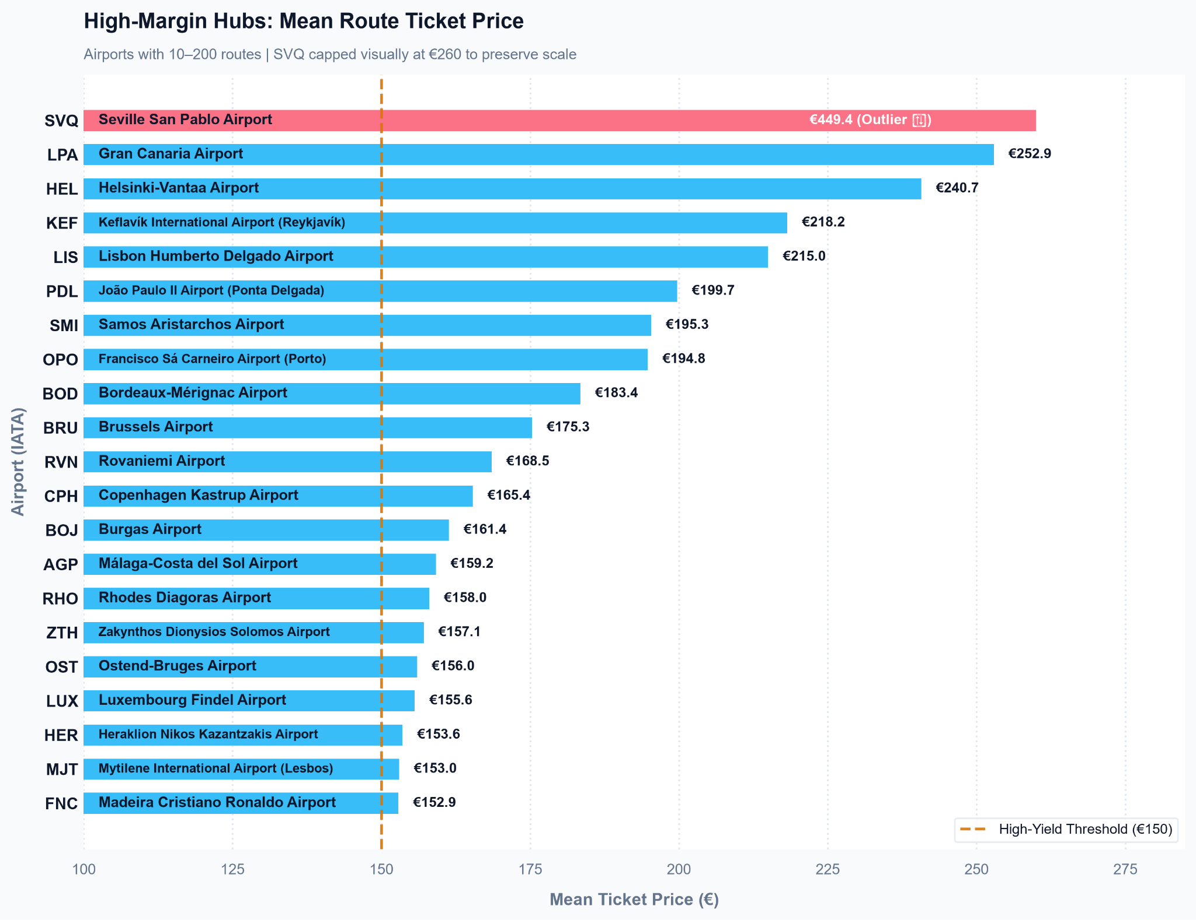
RESEARCH QUESTION 1
Exploratory Data Analysis: 1. Ticket Prices & Market Yield
01. Network Filter
<10 routes - filtering the lack of sufficient traveler demand
>200 routes - excluding saturated mega-hubs
02. Pricing Resilience Verdict
Mean ticket price: €150 threshold to keep the target in the moderate, defensible route range
03. Outliers: SVQ
Surface Mean: €449 vs. True Median: €50
Seville's mean fare is severely distorted by extreme fare anomalies (Std Dev > €2,300).
04

Slide 5
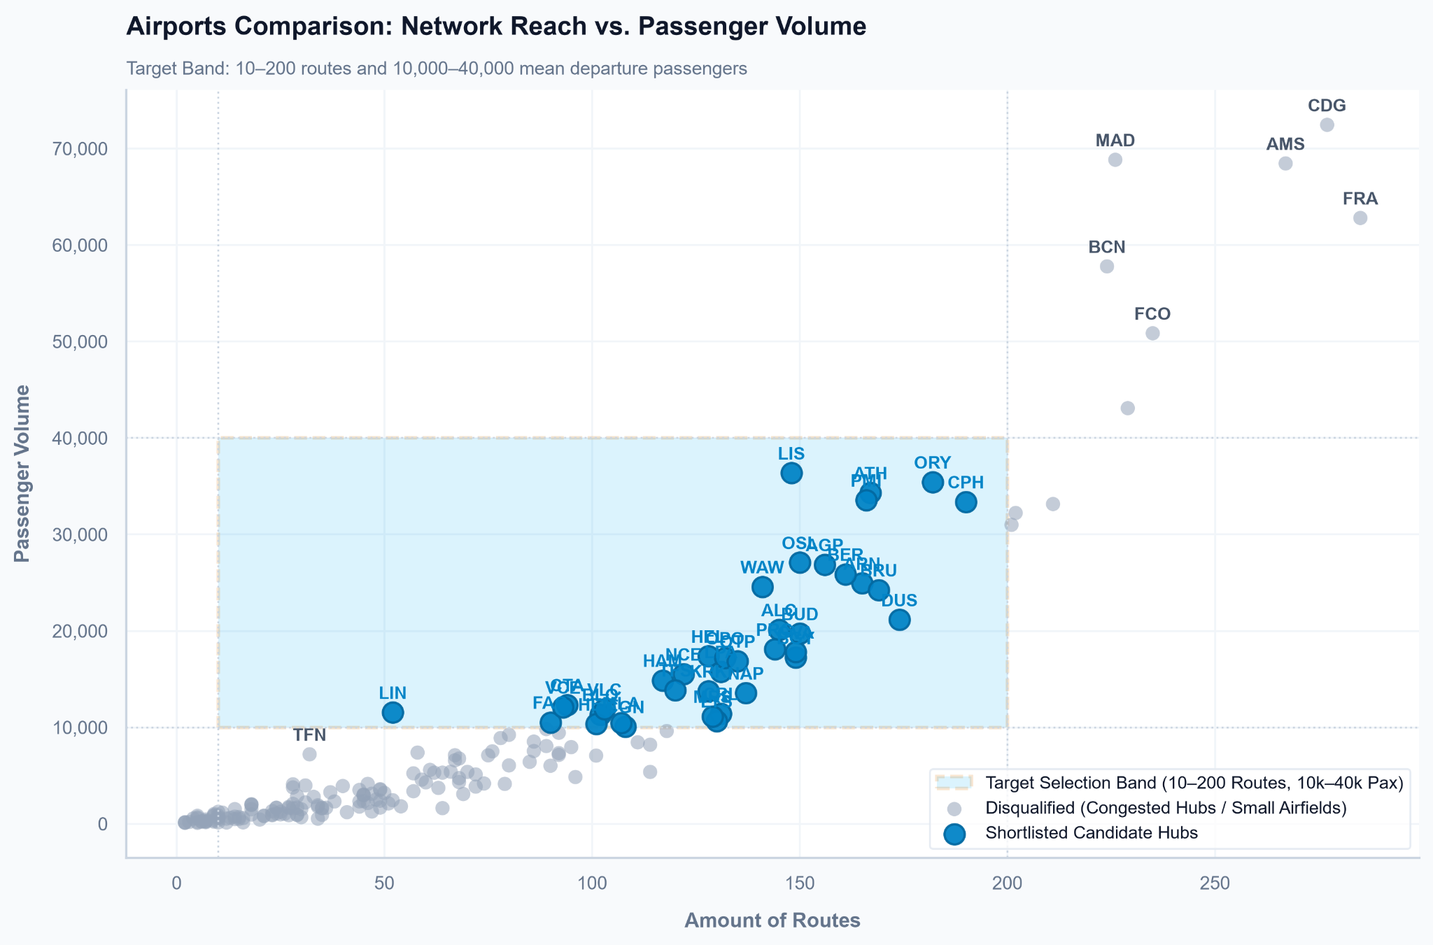
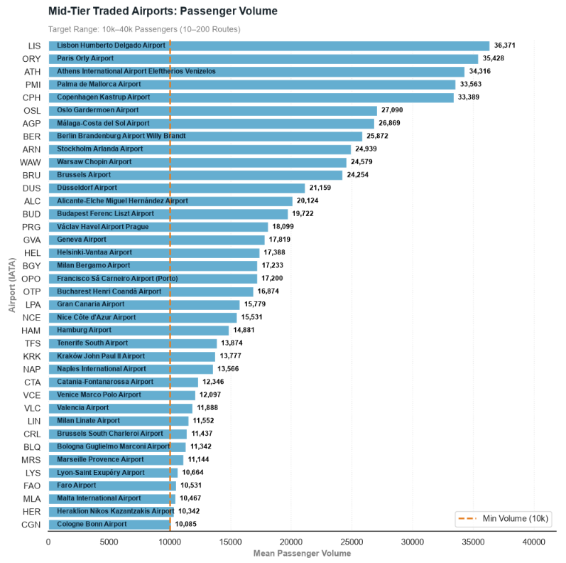
RESEARCH QUESTION 2
Exploratory Data Analysis: 2. Route Competition & Market Concentration
Passengers Volume
Requirements:
10k - 40k Passengers / Year
10-200 Routes
Result: 38 airports that meet the requirements. Taking out Big Hubs and Low Traffic Airports.
05

Slide 6
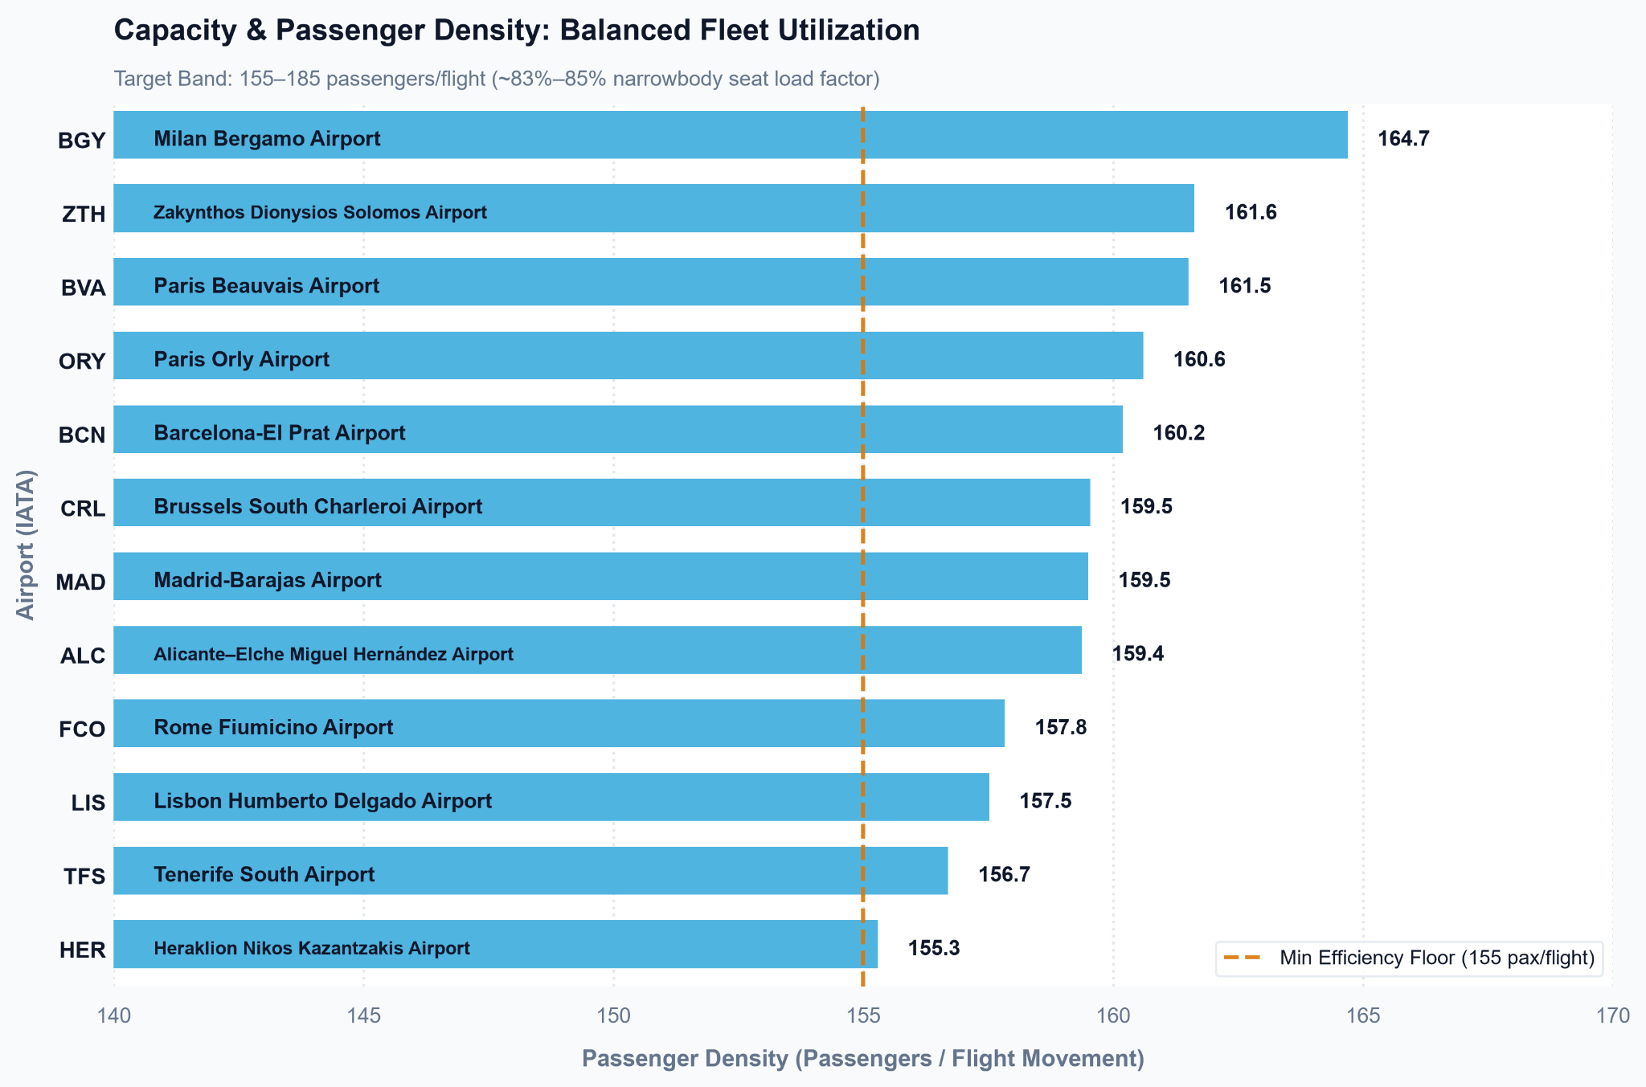
RESEARCH QUESTION 3
Exploratory Data Analysis: 3. Capacity & Passenger Density
HEALTHY DENSITY
155–185
Passengers per Flight Movement
Corresponds to ~80% seat load factor on standard A320 / B737 narrowbody aircraft.
06

Slide 7

AGILE METHODOLOGY EXECUTION
Teamwork & Project Management
1
2
3
Kanban Setup
Tasks distribution
Strategic Alignment
Structured Trello board for project planning and tasks tracking
Dividing Trello tasks between us along the project
Reviewing project flow and next steps definition
07

Slide 8
PROJECT RETROSPECTIVE
Major Obstacles & Key Learnings
01
THE OBSTACLES
02
WHAT WE LEARNED
03
WHAT WE'D DO DIFFERENTLY
block API Rate Limits & Data
Live transponder APIs imposed strict paywalls and call quotas.
alt_route Overcomplicating Scope
Deep dive into multi-variable calculations clouded the business objective early on.
lightbulb Progress Over Perfection
In data analytics, no dataset or initial plan is definitive, forward momentum is what counts.
track_changes Commercial Alignment
Every statistical metric must tie directly to an actionable airline ROI.
ac_unit Freeze the Data Stack First
Consolidate all primary tables (Eurostat, traffic, routes) before starting cleaning or chasing supplementary datasets.
directions_run Crawl, Walk, Run Approach
Start with basic aggregates and simple goals first to establish the business storyline before engineering granular features.
08

Slide 9
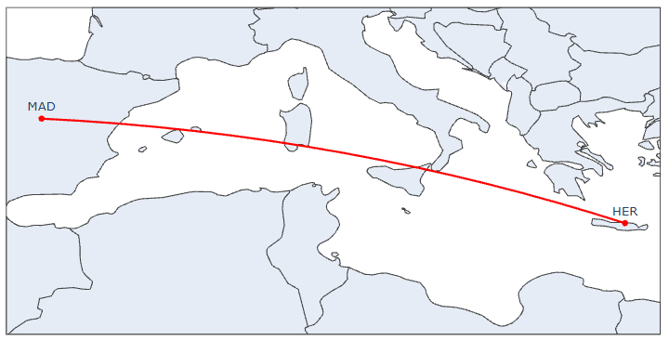
FINAL RECOMMENDATION
Conclusion and Insights
HER
MAD
WINNER
Premium Yield Potential
High average ticket prices protect operational margins.
Heraklion
(Crete, Greece)
Madrid
(Spain)
Direct Mediterranean connection capturing strong point-to-point tourism without transit stops.
2. Route Volumes & Market Concentration
High traveler volume but lower direct routes amount
3. Capacity & Passenger Density
High traffic density fits perfectly inside the passenger band.
Extra: Zero Direct Competition
Non existing current direct routes offers
09

Slide 10
FUTURE RESEARCH ROADMAP
Next Steps: Advanced Research & Model Refinement
01
TEMPORAL & SEASONAL DEPTH
02
TARGET REGIONAL TOURISM
03
DYNAMIC PRICING & NETWORK SCOPE
Month-by-Month Trends
Track peak summer vs. off-peak winter drops.
Day-of-Week Scheduling
Isolate Fri/Sun leisure spikes vs. midweek base.
Greece & Spain Deep-Dive
Analyze macroeconomic inbound tourism flows.
Secondary Airport Value
Re-evaluate overlooked, lesser-known regional gateways for hidden gem niche routes.
Paid Flight API Subscription
Capture live price ranges across off-peak, shoulder, and peak holiday travel periods.
Route Profitability Modeling
Conduct extensive financial analysis prior to commercial launch.
10

Slide 11

HAMBURGAIRLINES
Thank you!
Sofija Šarafejeva • Pablo Ferreira
Data Analytics Feasibility Team
11

